Slide 1
Shortage and Surplus
By: Ben Quick

Slide 2
Equilibrium Price (Review)
In order to understand shortage and surplus, we must first understand equilibrium or market clearing price
Equilibrium price is the price at which quantity supplied and quantity demanded meet

Slide 3
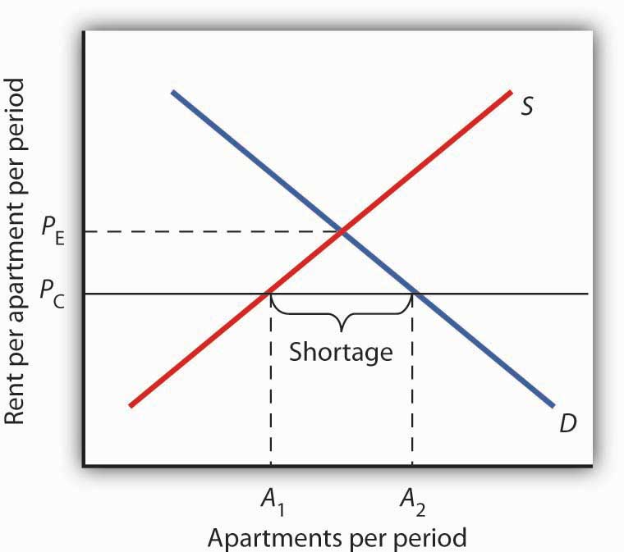
Shortages
A Shortage occurs when quantity demanded exceeds quantity supplied
A Price Ceiling is a legal maximum that can be charged for a good

Slide 4
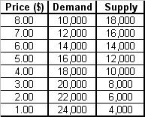
Example create a graph using the following information
What would happen if the government capped the price at $5?

Slide 5
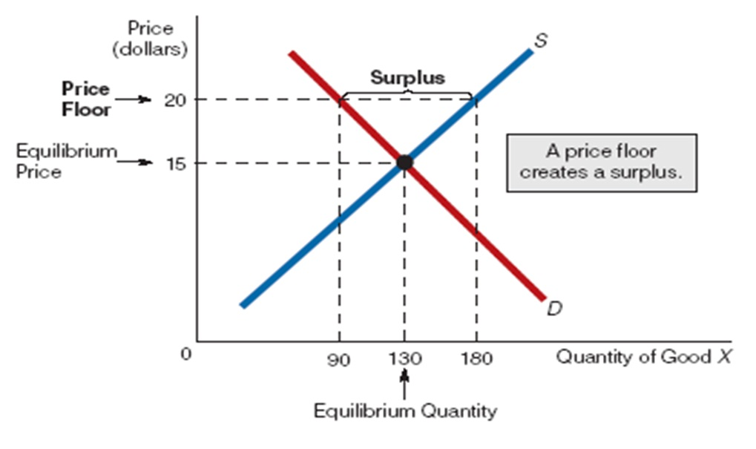
Surplus
A surplus occurs when quantity supplied exceeds quantity demanded
A price floor is a legal minimum that can be charged for a product

Slide 6
Example
Create a graph using the following:
Product: unskilled Labor
What would happen if government capped prices at $9
Price | Demand | Supply
$3 | 50 million | 30 million
$6 | 30 million | 40 million
$9 | 10 million | 50 million
$12 | 5 million | 60 million

Slide 7
Questions?

