Slide 1
Demand
By: Ben Quick

Slide 2
Demand in our Economy
Demand – The amount of want people have for an item
How much people want or need a good or service
In America, there is a high demand for oil because people want and need to drive

Slide 3
Law of Demand
States that quantity demanded and price have an inverse relationship.
- as price goes up, demand goes down
As price goes down, demand goes up

Slide 4
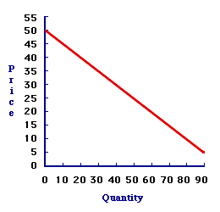
Graphing Demand

Slide 5
Questions?

