Slide 1
GDP, Spending, and Economic Growth
By: Ben Quick

Slide 2
Review: GDP
The market value of all final goods and services produced within a country in a given period of time.
GDP = Consumption + investment + government spending + (exports – imports)
GDP = C+I+G+F

Slide 3
GDP and the Economy
The Business Cycle shows us that if the GDP declines or grows too slowly, the economy will be in recession

Slide 4
WHY?
Because if producers do not continually expand, the people will not have jobs
The Unemployment Rate is tied directly to Consumer Spending (70% of our GDP)
If people stop buying, companies will stop producing and people will lose their jobs
GDP shows us how much consumers are demanding

Slide 5
Spending
The economy grows when spending increases
- consumer spending
- Business Spending (capital investment)
- Government Spending (Public Goods)
- Foreign Spending (exports)
This spending increases GDP

Slide 6
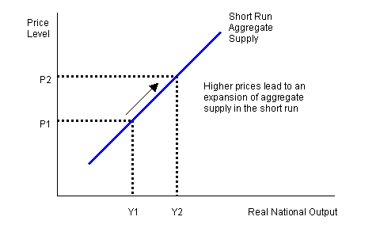
Aggregate Supply
Total Supply of goods and services produced by a national economy during a specific time

Slide 7
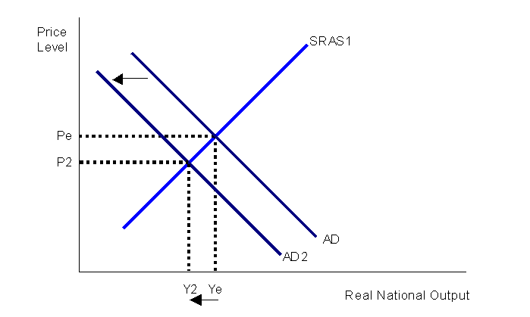
Aggregate Demand
Total Demand for final goods and services in the economy during a specific time period

Slide 8
Questions?

