Slide 1
Business Cycle
By: Ben Quick

Slide 2
Business Cycles in the U.S.
The business cycle consists of two phases: Expansion and recession
Recession begins with a peak and ends with a trough
Expansion is the recovery from a recession

Slide 3
Business Cycles
If a recession becomes severe, it can turn into a depression
A recession occurs when there are two quarters in a row of negative growth
There is no measurement for a depression, it is opinion generally assigned years later.

Slide 4
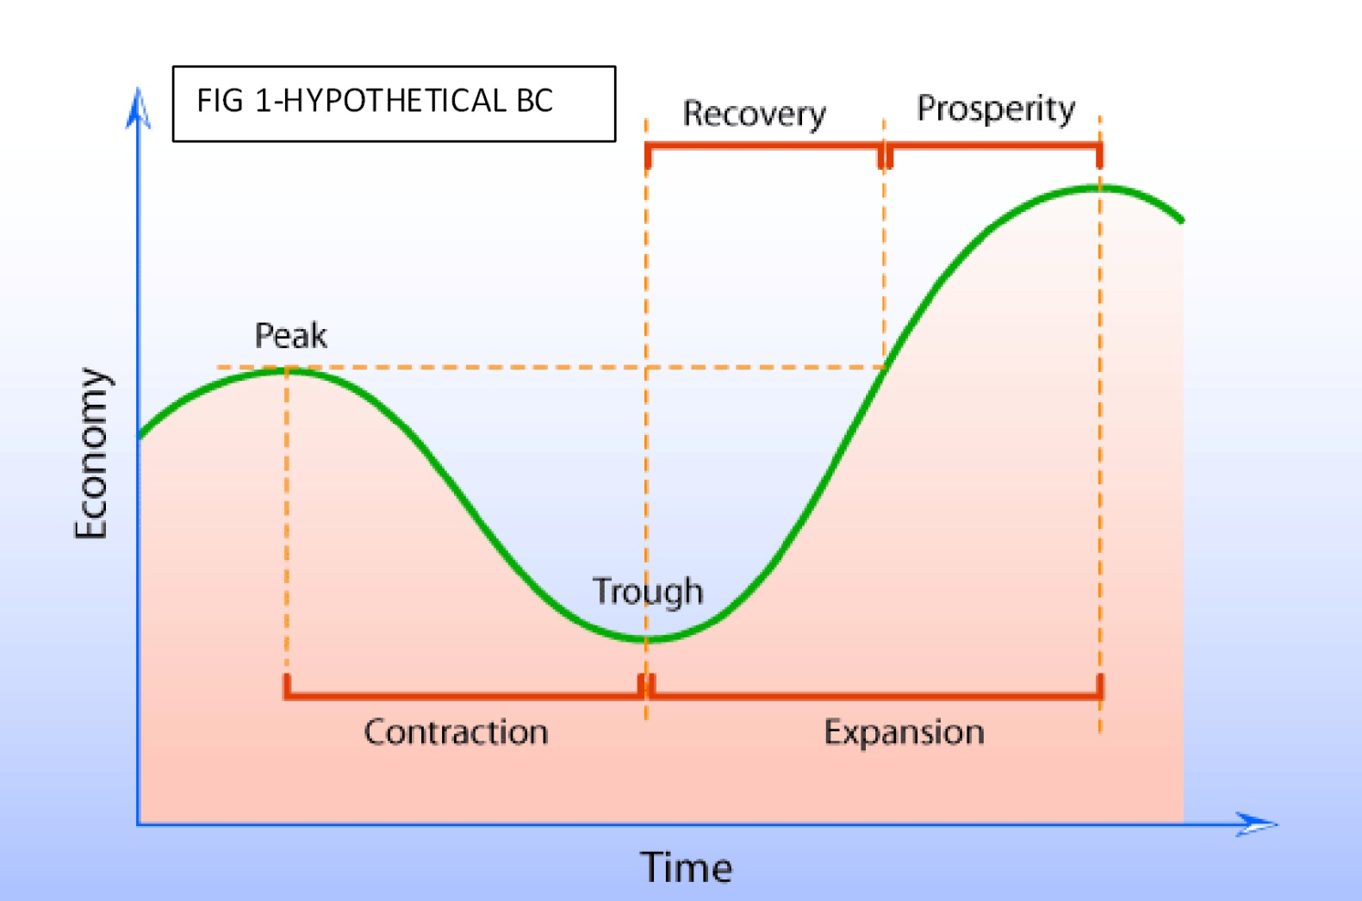
The Business Cycle

Slide 5
Remember:
There are two phases to the Business Cycle: Expansion and Recession
Recessions are a decline in any country’s Gross Domestic Product for two or more successive quarters
Stagflation occurs when both inflation and unemployment are high (1970’s in U.S.)

Slide 6
Questions?

