Slide 1
Inflation
By: Ben Quick

Slide 2
Inflation in the United States
Inflation is an upward movement in the average level of prices.
It’ opposite is Deflation, a downward movement in the average level of prices.

Slide 3
Causes of Inflation
Too Much Spending – occurs when all sectors of the economy try to buy more goods and services than the economy can produce. Sometimes inflation is caused by the federal governments deficit spending
Costs Go Up – occurs when input costs, especially labor, drive production costs up
Excessive Monetary Growth (Money Supply) can cause inflation (printing too much money)

Slide 4
Consequences of inflation
The dollar buys less
Hurts people with fixed income
Can cause people to change their spending habits which disrupts the economy

Slide 5
How do We Measure Inflation?
CPI – Consumer Price Index
- a statistical estimate of the level of prices of goods and services bought for consumption purposes by households
In other words, CPI measures how much the things we buy costs

Slide 6
CPI (Con’t)
Let’s say CPI in 2013 is $100 and the CPI in 2014 is $110.
This would mean that prices increased from 2013 to 2014, and that we experienced 10% inflation during that period. This also means that the value of the dollar decreased from 2013 to 2014.
Historically, inflation runs at about 3% (3.22%, 1913-2013)

Slide 7
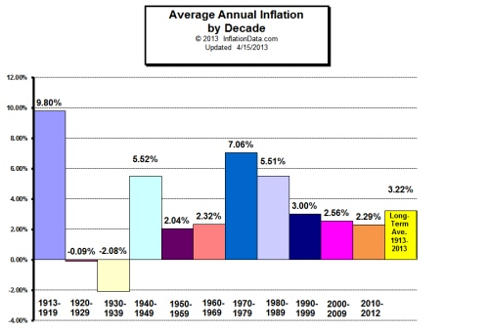
History of Inflation

Slide 8
Questions?

