Slide 1
Supply and Demand Together
By: Ben Quick

Slide 2
Equilibrium Price
The price of any good or service supplied will find the level at which the quantity demanded and the quantity supplied are balanced
Point where supply and demand meet
Market clearing price

Slide 3
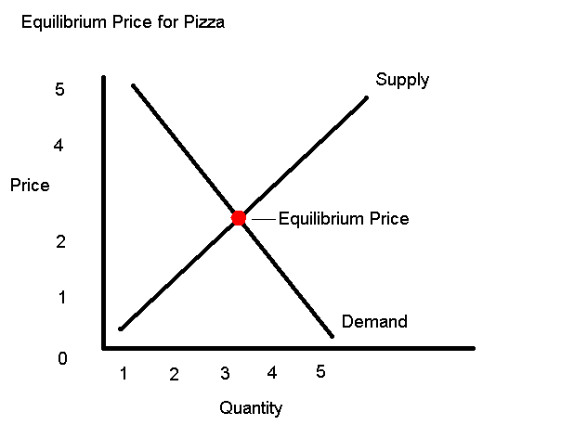
Example of Equilibrium Price

Slide 4
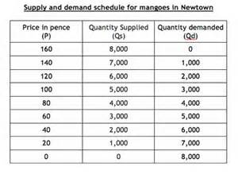
Equilibrium Price from Data

