Slide 1
Supply
By: Ben Quick

Slide 2
Law of Supply
Supply and Price move together.
As the price rises for a good, the quantity supplied rises.
As the price falls, the quantity supplied also falls.
Profit Incentive- The higher the price, the greater the incentive is for a producer to produce more.

Slide 3
Supply (Cont.)
Supply is derived from a producer’s desire to maximize profits.
When the price of a product rises, the supplier has an incentive to increase production because he can justify higher costs to produce the product, increasing the potential to earn larger profits
Profit is the difference between revenues and costs

Slide 4
Supply Curve
A supply curve is a graphical depiction of a supply schedule plotting price on the vertical axis and quantity supplied on the horizontal axis.
The supply curve is upward-sloping, reflecting the law of supply.

Slide 5
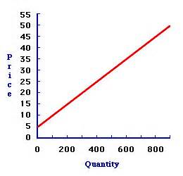
Example of a Supply Curve

Slide 6
Example of Change in Supply
Suppose for example that the video store purchases its videos from Hollywood Inc. but Hollywood Inc. just increased its prices.
Now the video rental store has to pay more to purchase the videos that it makes available to customers.
For a given rental price of videos, the video store has to reduce the quantity of video it supplies.
For the same price, quantity supplied will be lower than before.

Slide 7
Change in Supply
As with demand curves, it is essential to distinguish between a movement along a given supply curve and a shift in supply curve.
A change in price results in a movement along a fixed supply curve.
This is also referred to as a change in quantity supplied.
A change in any other variable that influences quantity supplied produces a shift in the supply curve or a change in supply.

Slide 8
Change in Supply

Slide 9
Determinants of Supply
Taxes
Regulations
Inputs, cost of
Number of Firms in Industry
Education
Technology

