Slide 1
Change In Demand
By: Ben Quick

Slide 2
Review: Price and Quantity Demanded
The relationship between the quantity demanded and the price is one in which as the price goes up, the quantity demanded goes down.

Slide 3
Change in Demand v. Change in quantity demanded
It is essential to distinguish between movement ALONG a demand curve and a SHIFT in the demand curve
A change in price results in a movement along a fixed demand curve
This is also referred to as a change in quantity demanded.
If the entire curve moves or shifts, then it is referred to as a change in demand

Slide 4
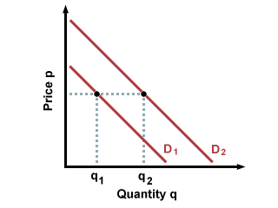
Example of change in demand

Slide 5
Determinants of Demand
Factors that cause a change in demand
Six Factors:
- Supplementary Goods
- Expectations
- Population
- Taste
- Income
- Complementary Goods

Slide 6
Complementary goods
One product often used with another
Example:
- Bread and butter can be used separately, but are often used together
- If there is a decrease in the price of bread, then there will be an increase in the demand for it’s complementary good, butter.

Slide 7
Supplementary Goods
Supplementary goods are goods that can supplement other goods.
Ex: Coke or Pepsi
Jiff or Peter Pan peanut butter
If the price increases for one, it can easily be substituted by another brand at a lower price

Slide 8
Question?

