Slide 1
Other Market Structures
By: Ben Quick

Slide 2
Monopolistic Competition
Market structure where there are many sellers and buyers, products are similar and there is product differentiation.

Slide 3
Characteristics of Monopolistic Competition
Numerous sellers
Easy entry
Product Differences
Non-price competition
Some control over price
Examples: soap, toothpaste, deodorant

Slide 4
Oligopoly
A few large interdependant sellers dominate and have the ability to affect prices in the industry
Examples: Airline industry, Automobile Manufacturers

Slide 5
Pure Monopoly
A situation in which there is only one seller of a specific product that has no substitutions

Slide 6
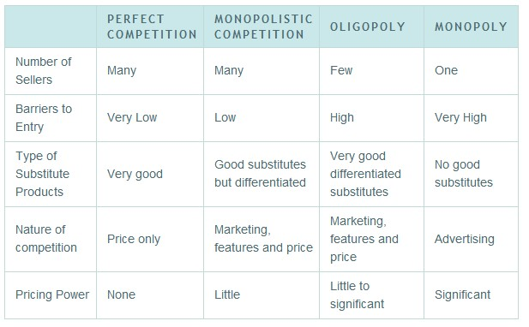
Four types of market structures

