Slide 1
Profit Motive and Circular Flow Model
By: Ben Quick

Slide 2
Profit
The extent to which a person or business is better off at the end of a period
Also can be defined as money made minus expenses (revenue – cost)

Slide 3
Motive
Reason for doing something
incentive

Slide 4
Profit Motive
Money is the incentive
We want to make more money than we spend.
Profit motive is the ONLY reason a person starts a for-profit company
Improving society, job creation, and innovation are secondary issues derived from profit seeking

Slide 5
Example 1
An individual is working for $9/hr. They are offered a job for $12/hr. Do they take the new job?

Slide 6
Example 2
ACME Bread Company can open up a new store in either Zebulon or Griffin. A new store in Zebulon will make $37,000/yr, while a new store in Griffin will make $89,000/yr.
Which town should they choose?

Slide 7
Example 3
Nacom is thinking about adding 2 new positions that pay $14/hr. What would Nacom need to know before making this decsion?

Slide 8
The Consumer
Q- How do consumers benefit from entrepreneurs focusing on making profits?
A – Entrepreneurs will produce products that consumers want and sell at prices that consumers are willing to pay. Also, producers will work to improve products to attract more consumers

Slide 9
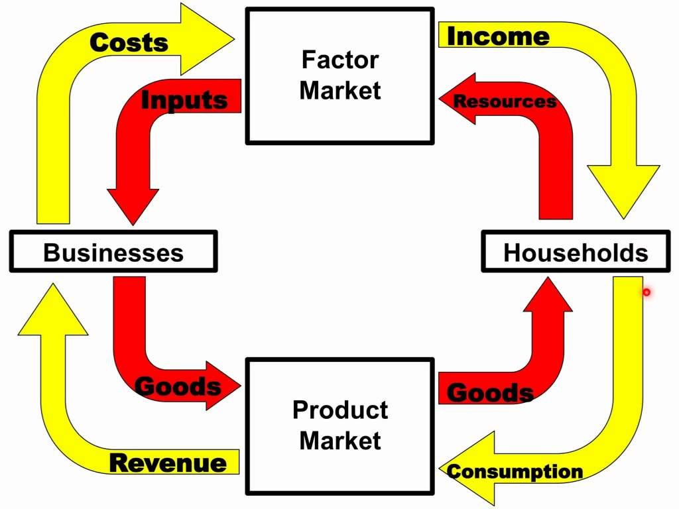
Circular Flow Model

Slide 10
Circular Flow Model (Cont)
Notice that goods and services and resources flow around the economy in one direction, while money flows around the economy in the opposite direction.
This is because money is normally exchanged for goods, services and resources

Slide 11
Circular Flow Model (cont)
Households (people), in the circular flow, own all the labor, land, and capital.
In the FACTOR MARKET, households sell the services of labor, land and capital in exchange for wages, rent and profits

Slide 12
Circular Flow Model (Cont)
In the PRODUCT MARKET, households spend their income on products that are produced by firms.

Slide 13
Questions?

